Slide 1
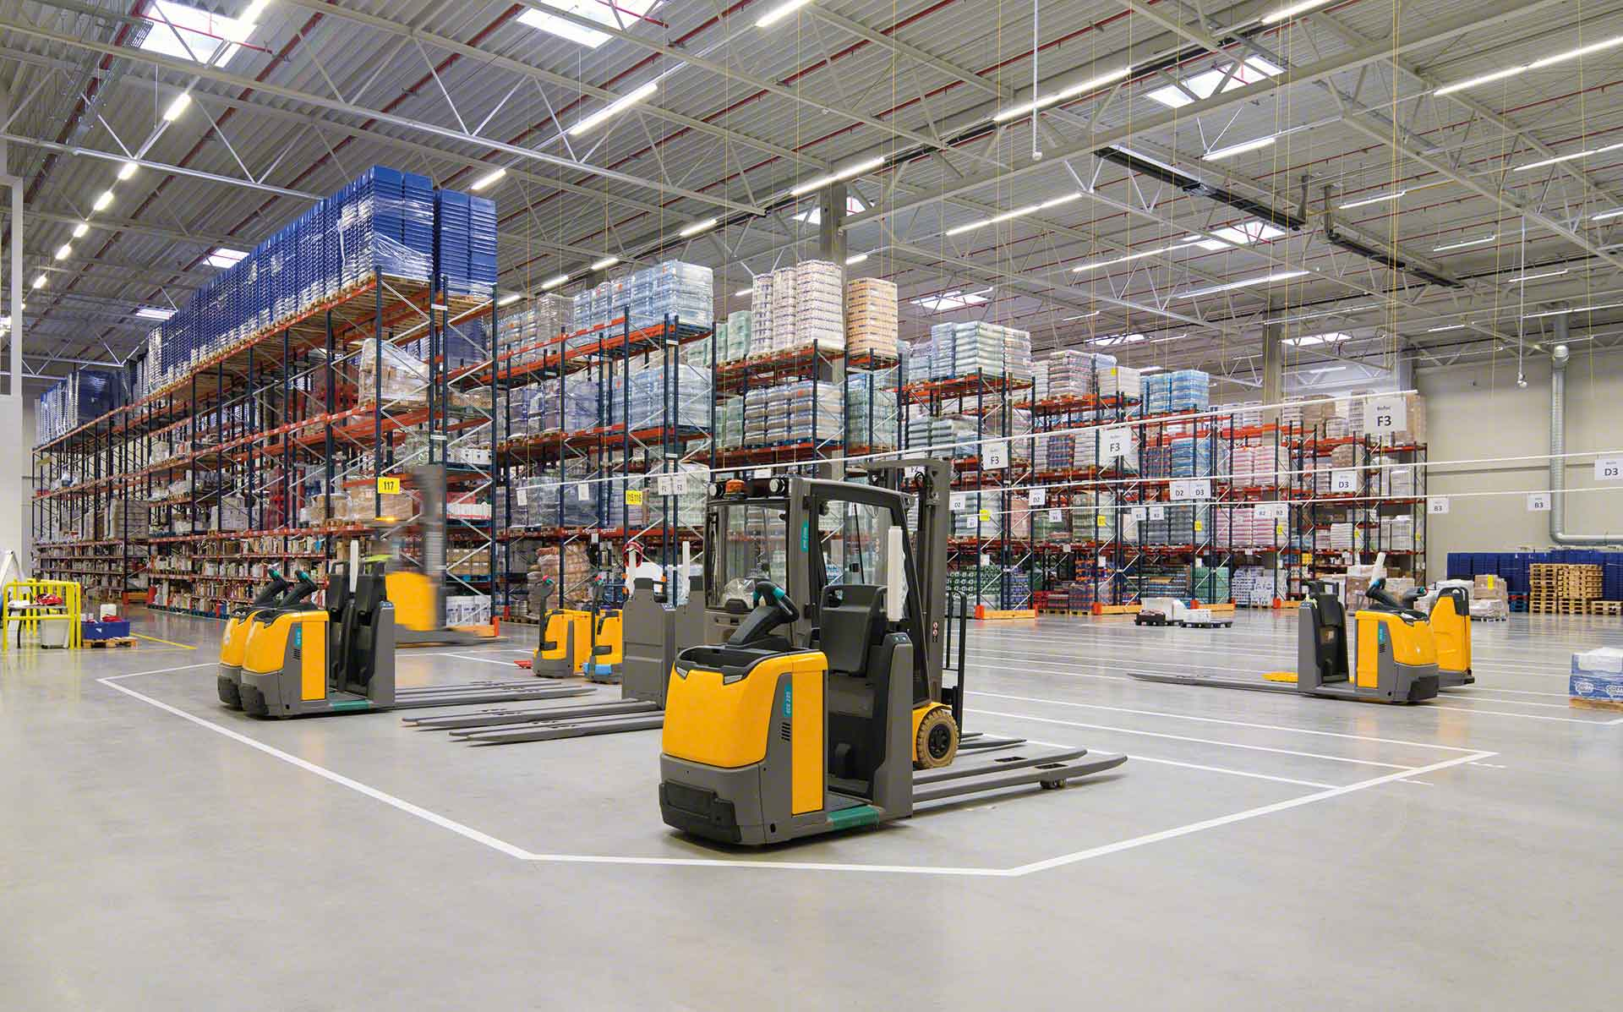

Material Handling KPI
November 2022

Slide 2
Material Handling moves
Total movements
4365
Row Labels | Sum of TOTAL
Oct | 14414
Nov | 11652
Grand Total | 26066

Slide 3
Adjustments
Adjustments difference
$1637.78
Row Labels | Sum of COST | Count of PART
jtobias | $1,225.83 | 4
jodelacr | $331.15 | 11
judelato | $80.80 | 1
Grand Total | $1,637.78 | 16

Slide 4
Labor intensive
Class not slotted count
11
Labor Intensive
23

Slide 5
restock
Part Numbers stocked
1308
Row Labels | Count of Part Number
Oct | 1287
Nov | 1308

Slide 6
Empty locations
Row Labels | Sum of Total de espacios disponibles
Jul | 316
Aug | 1586
Sep | 623
Oct | 3070
Nov | 1908
Grand Total | 7503
Actual empty locations
307

Slide 7
Discrepancies
Date | Sum of Locaciones
sep | 78
02-sep | 25
05-sep | 15
16-sep | 15
23-sep | 10
30-sep | 13
oct | 27
07-oct | 5
14-oct | 0
28-oct | 9
31-oct | 13
nov | 35
02-nov | 12
04-nov | 5
08-nov | 2
11-nov | 4
14-nov | 4
17-nov | 3
22-nov | 5
25-nov | 0
Grand Total | 140
Total discrepancies
0

Slide 8
Consolidation
Row Labels | Sum of count of consolidations
14/08/2022 | 27
28/09/2022 | 24
06/10/2022 | 35
13/10/2022 | 26
20/10/2022 | 20
27/10/2022 | 29
17/11/2022 | 18
24/11/2022 | 15
Grand Total | 194
Total Consolidations
194

